Slide 1


THE UNCALLED SIX
FOOD MAVEN – (Online Groceries Shop)
Members:
1.Sabari Rupa M.
2.Nandhitha K.P.
3.Abhishek P.
4.Raghul P.
5.Sivasankar K.
6.Preetha S.

Slide 2
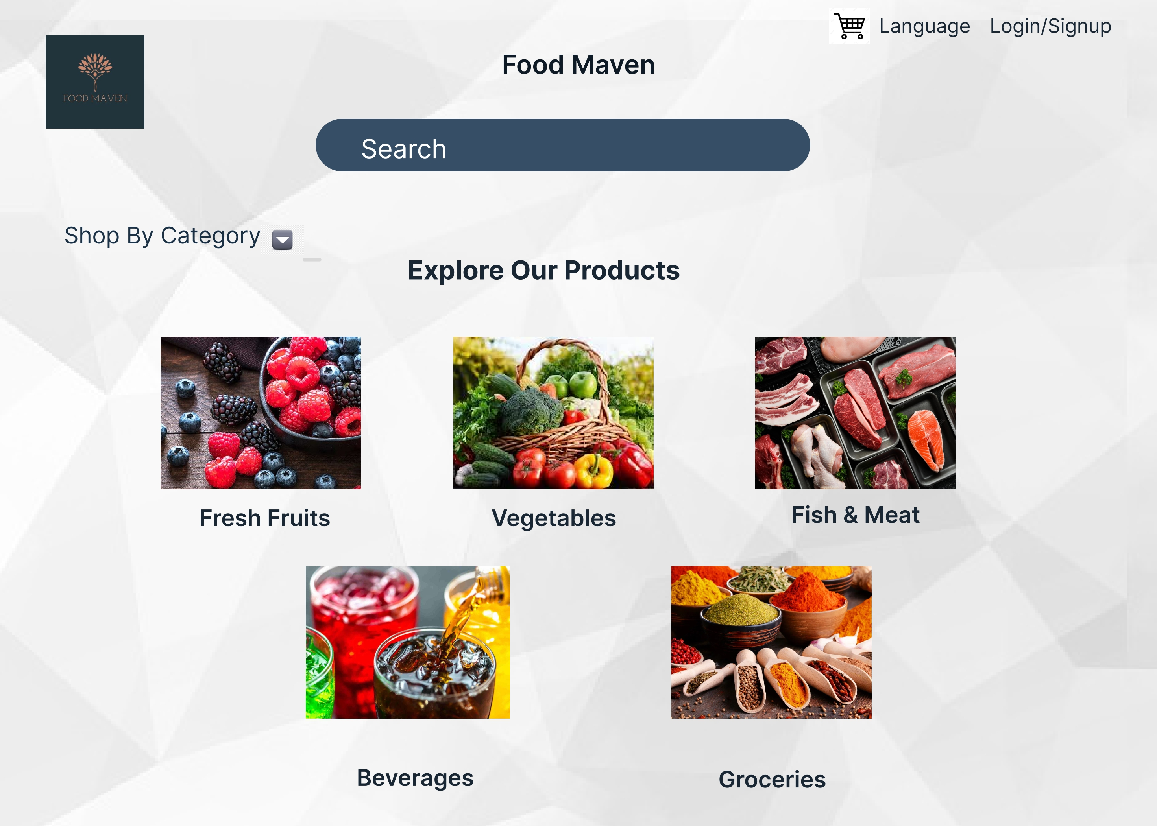
Language Login/Signup Food Maven Search Shop By Category Explore Our Products Fresh Fruits Vegetables Fish & Meat Beverages Groceries

Slide 3
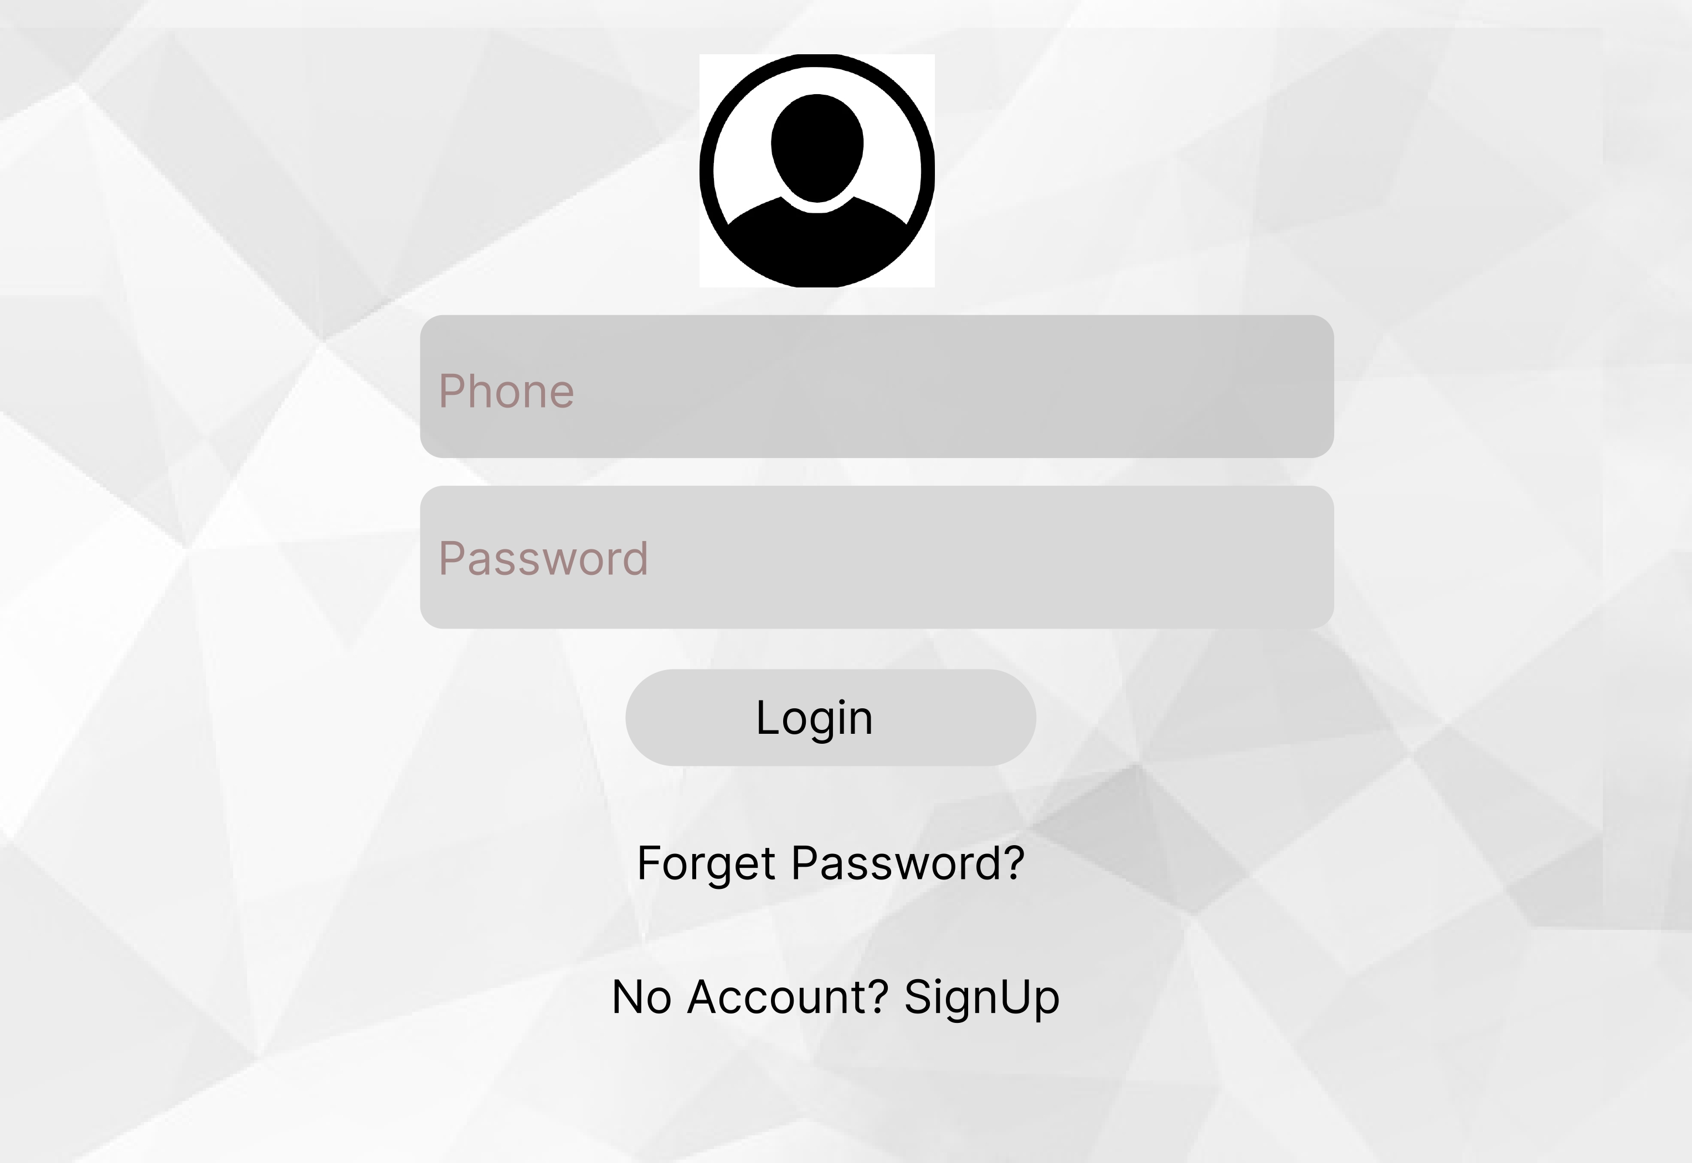

Slide 4
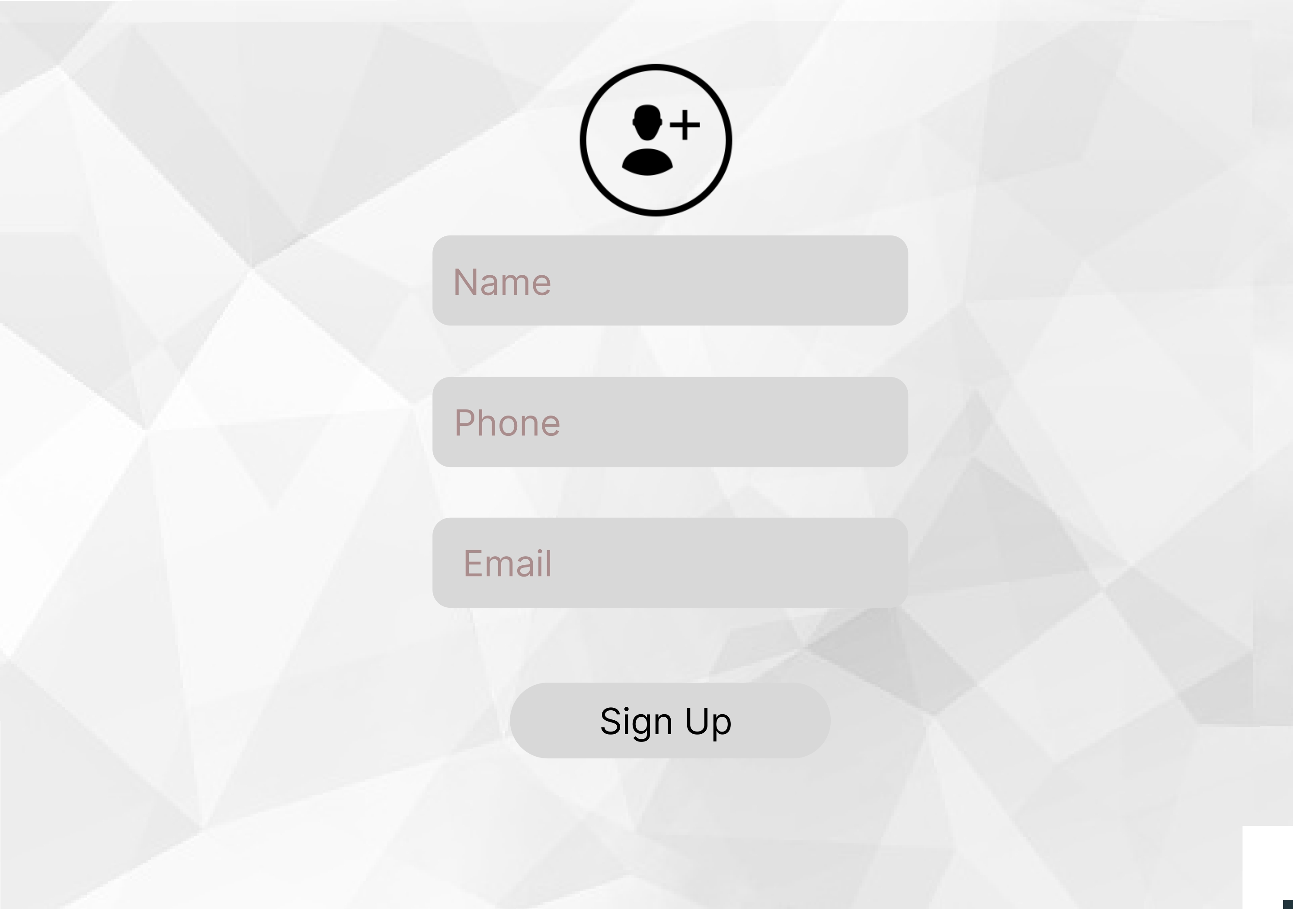

Slide 5
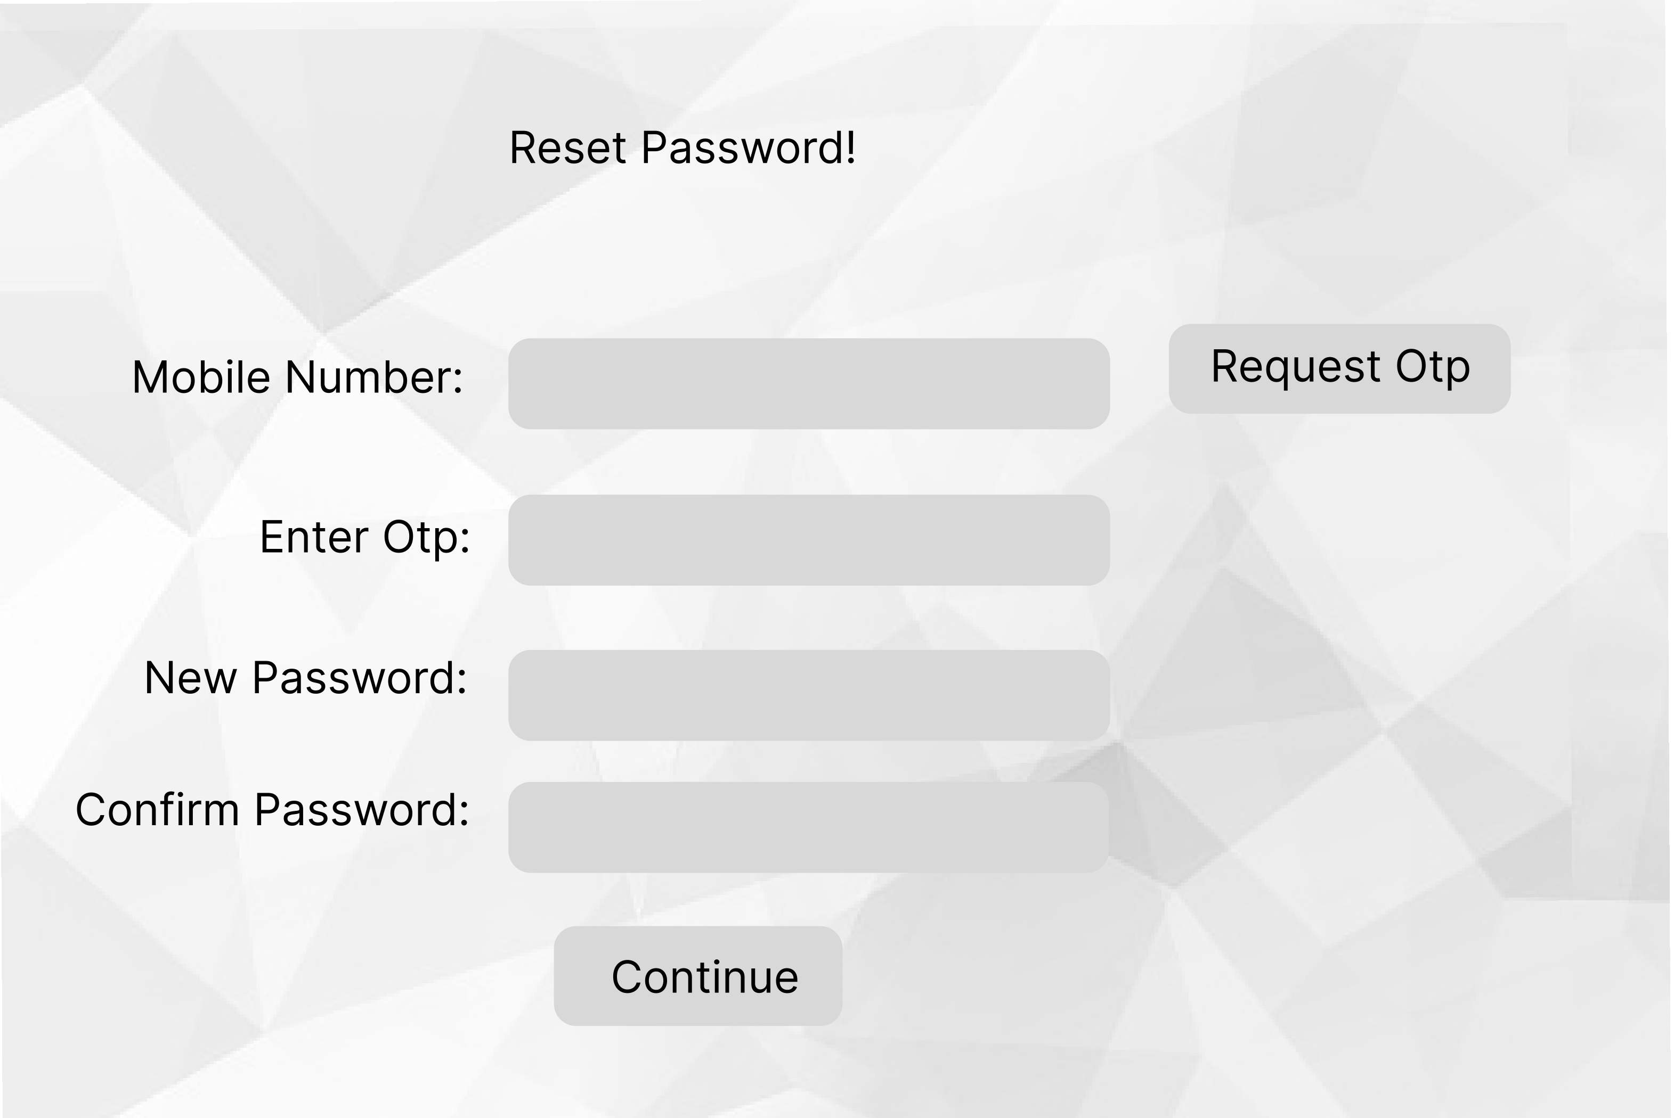

Slide 6
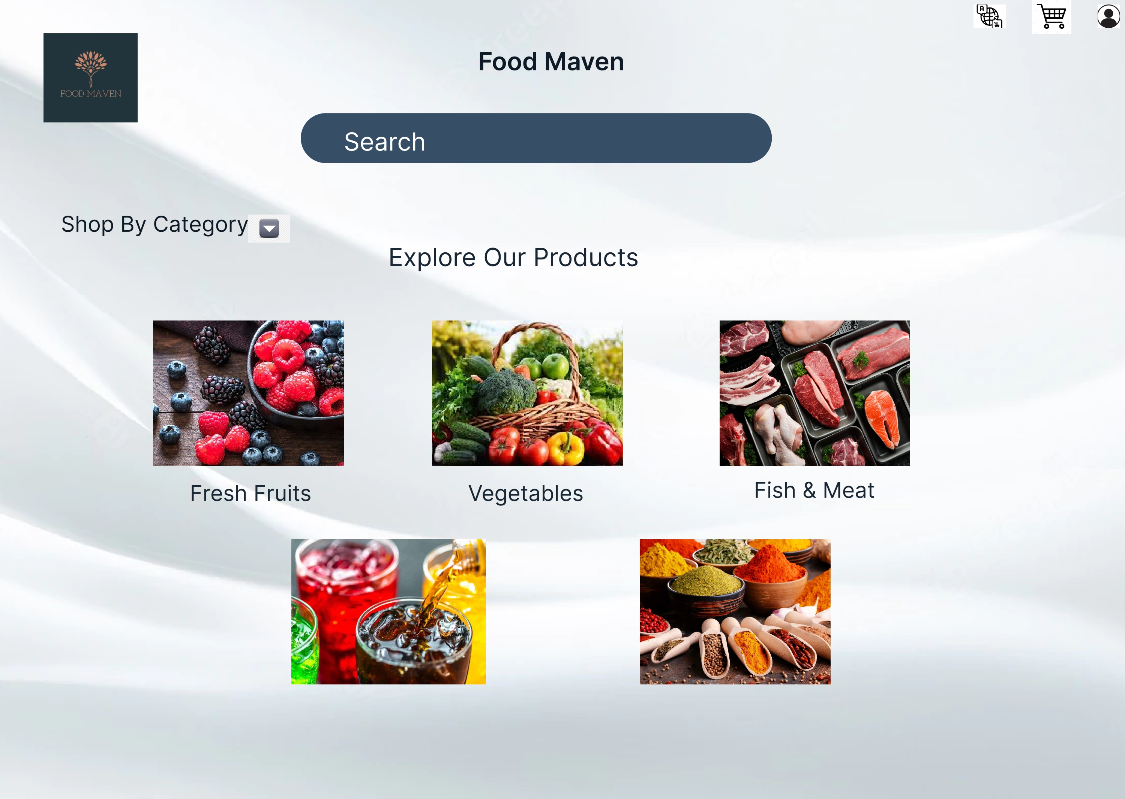

Slide 7
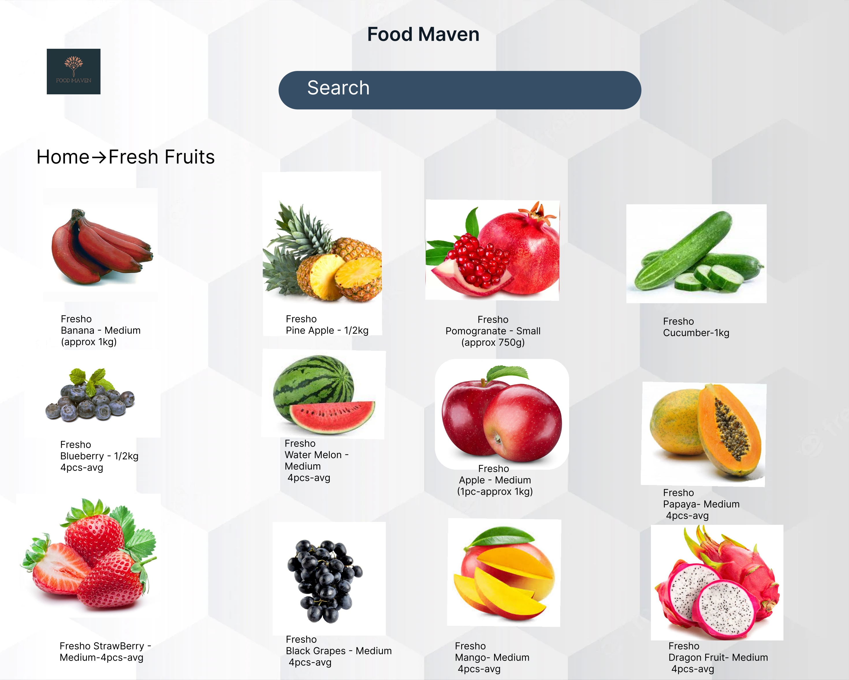

Slide 8
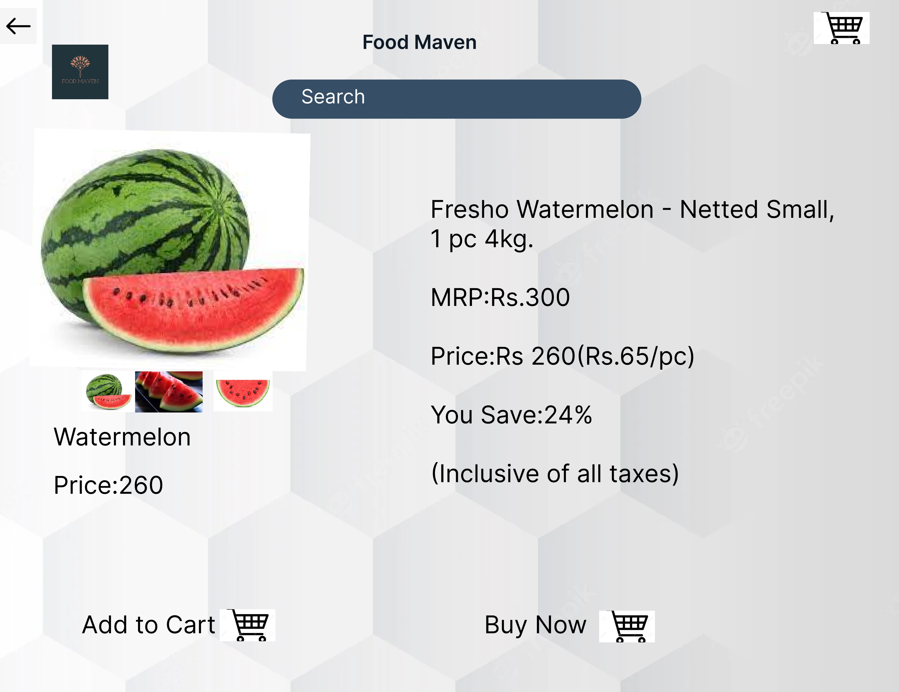

Slide 9
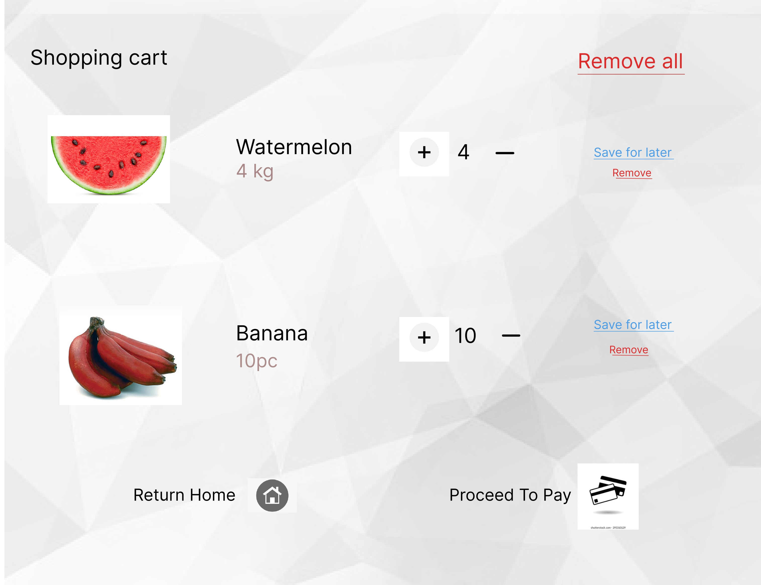

Slide 10
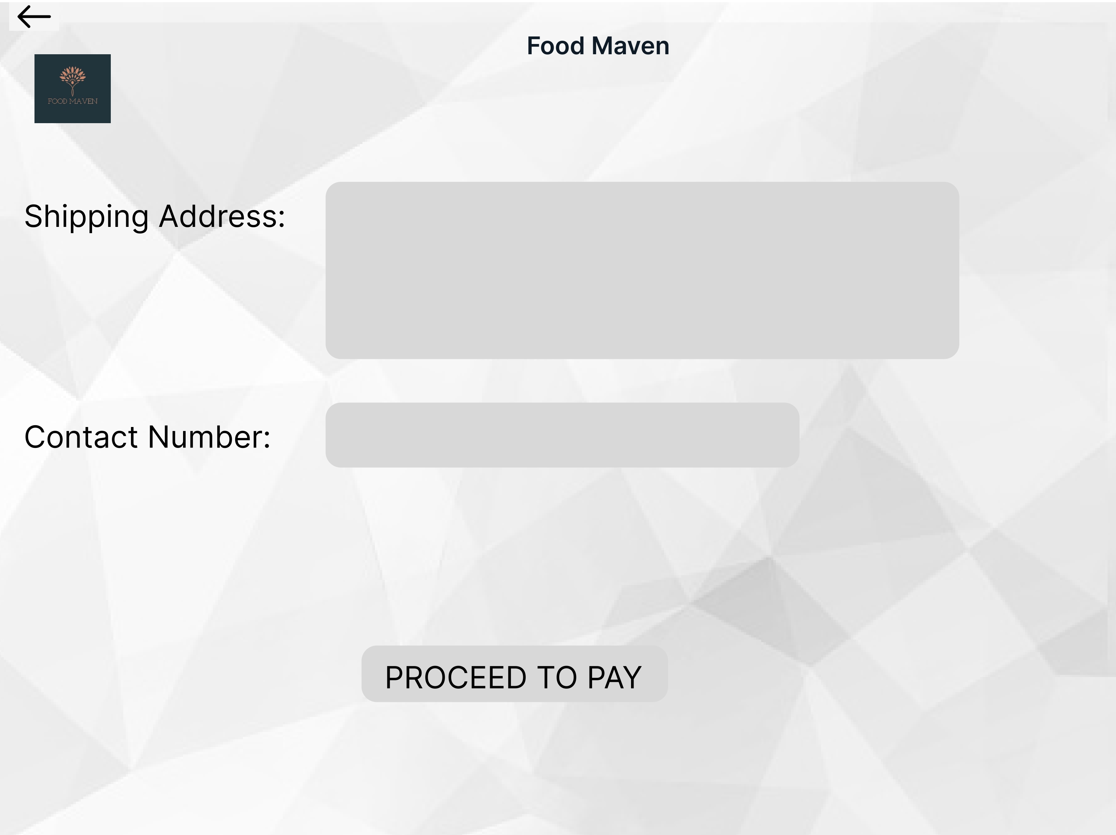

Slide 11

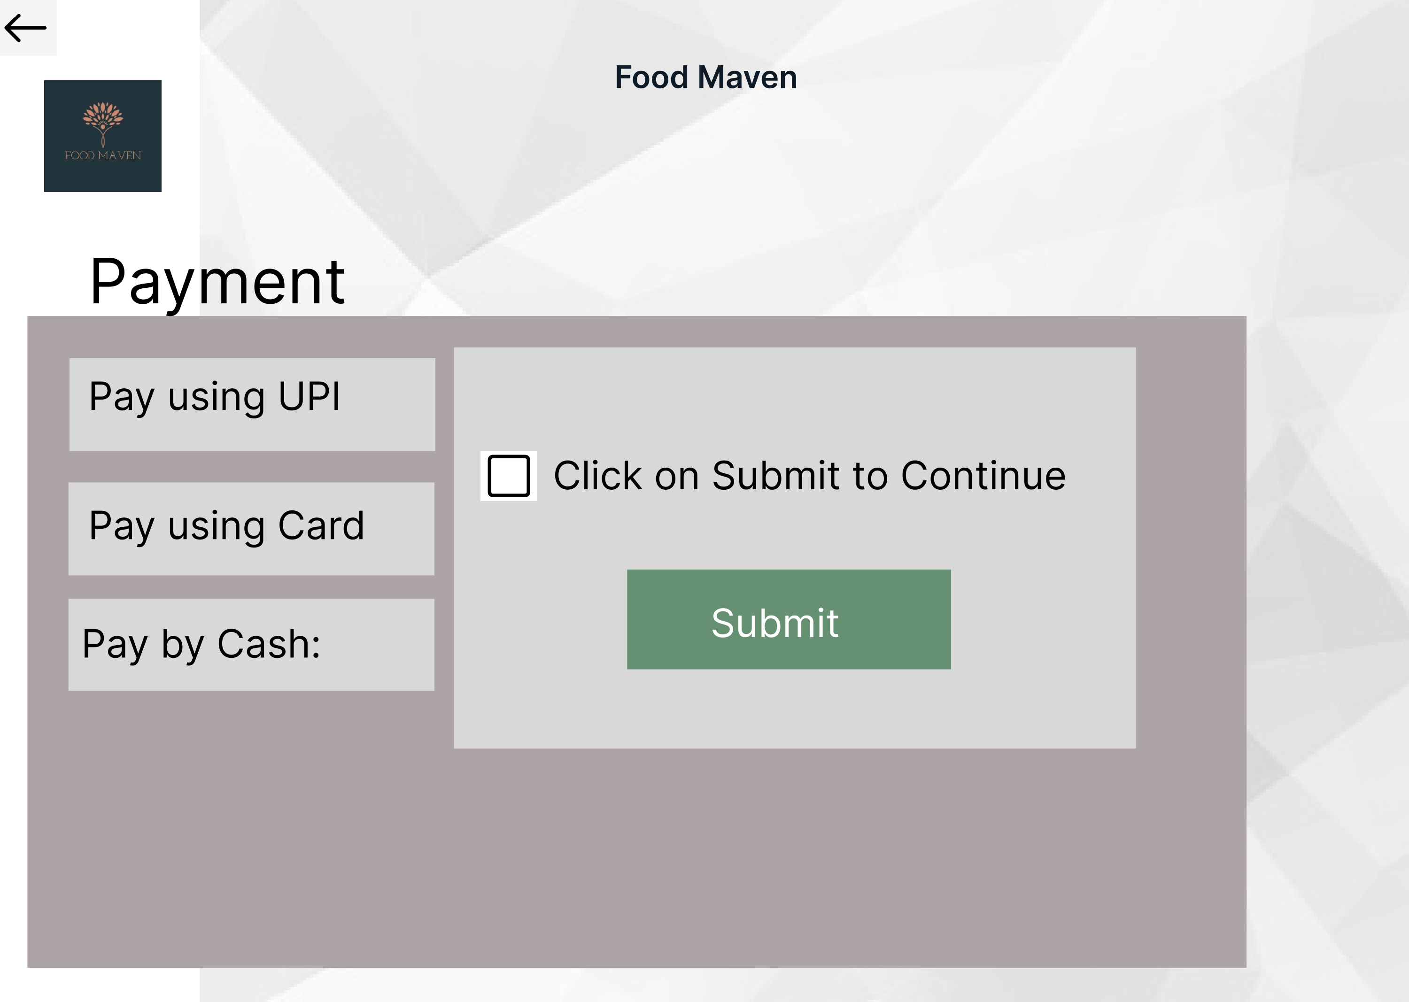
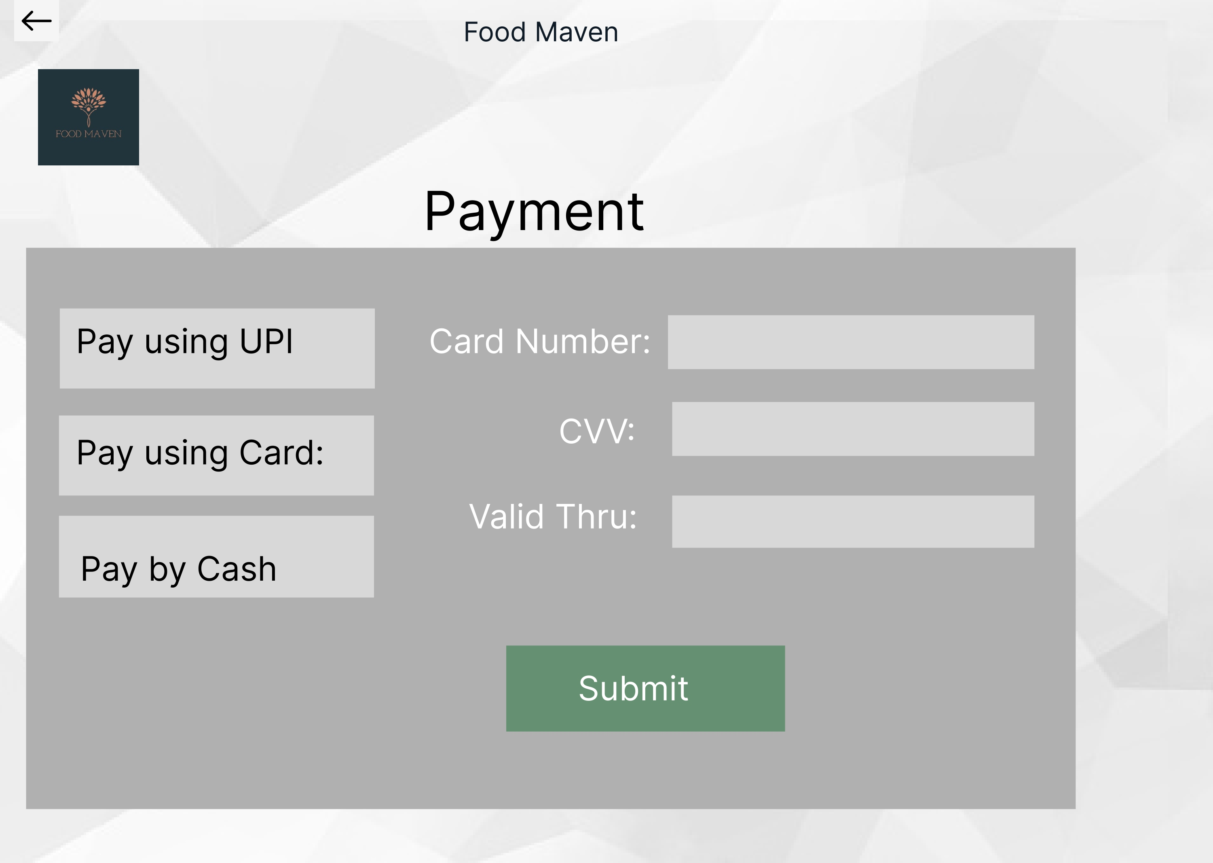
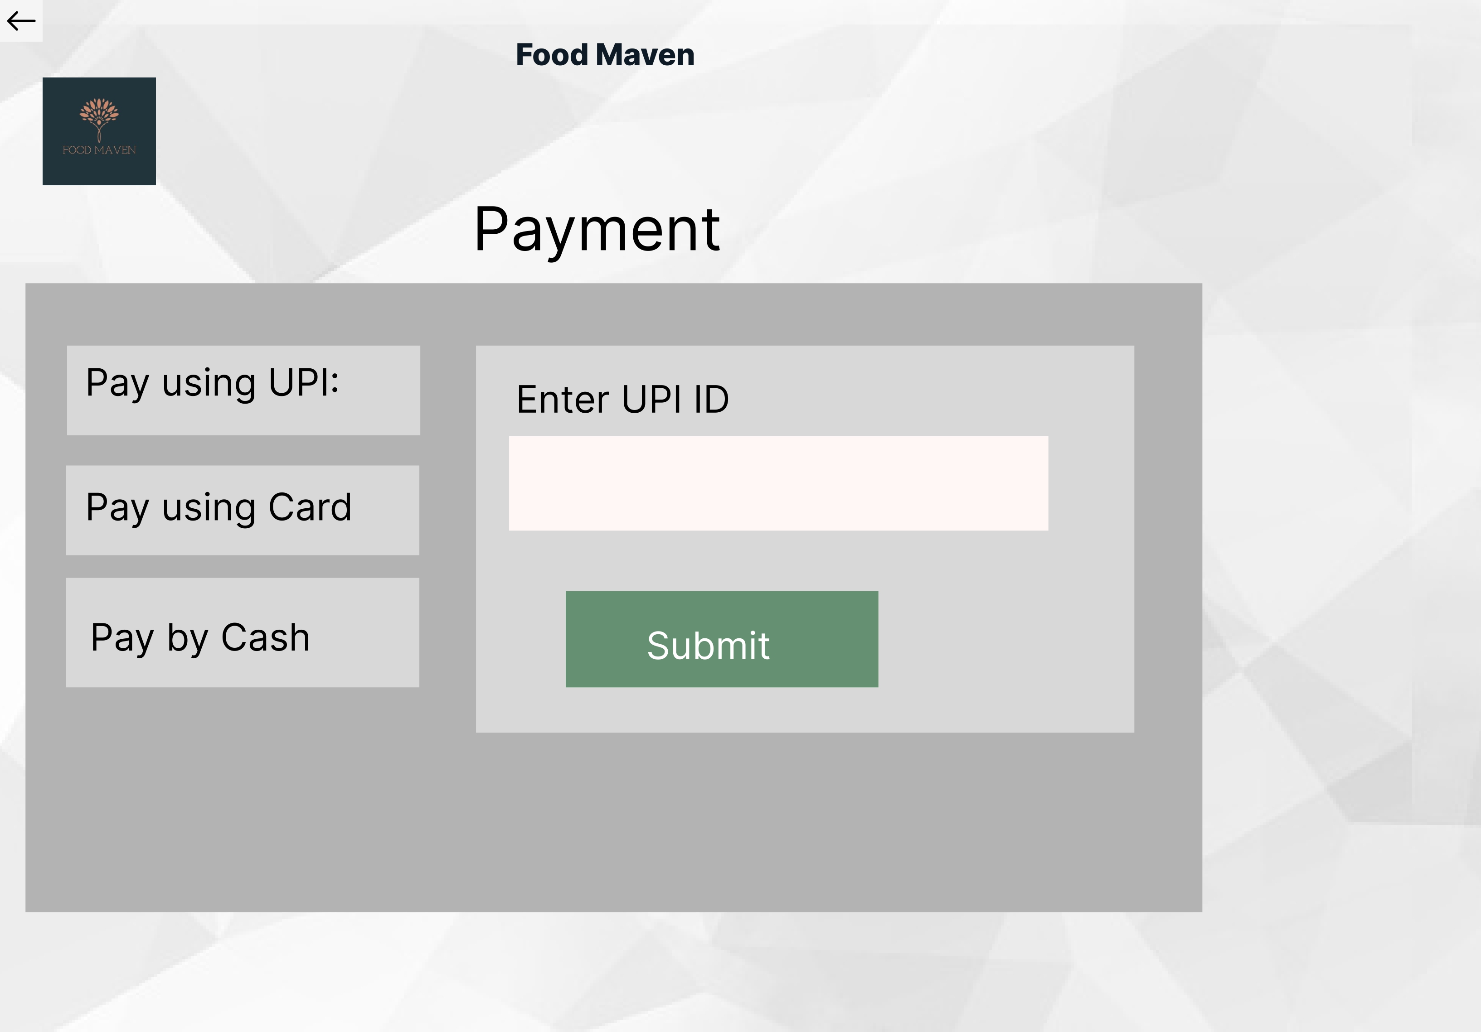

Slide 12
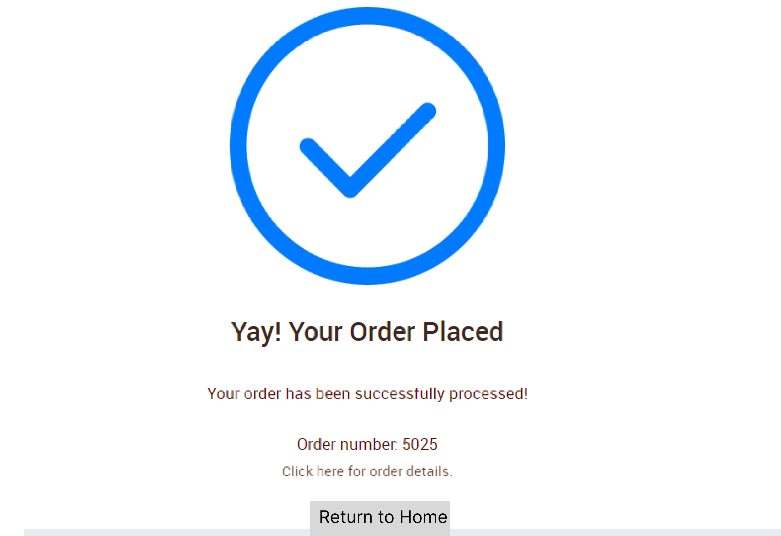

Slide 13
THANK YOU!!
Figma Link : https://www.figma.com/file/rgucr15d4MdkdEahI8B9Ek/Untitled?node-id=0%3A1&t=mKTR4TqP49ABSmtm-1
GitHub Link : https://github.com/SabariRupa FoodMaven.git
Thank you for Providing This Oppurtunity…..

